Slide 1

KLMUG12
-- WEB APIs and RUBY --
Website: http://mongodb.my
FB: facebook.com/groups/klmug
Twitter Handle: @klmug
--------------------------------------------------
GitHub: github.com/r1dotmy/klmugs
Notes:
1

Slide 2
REMINDERS
20 / 30 - Minute Presentations (use cases or technical demonstrations)
5 / 10 - Minute Lightening Talks
(knowledge share / shout-out)
BIG emphasis on Q&A
Notes:
2

Slide 3
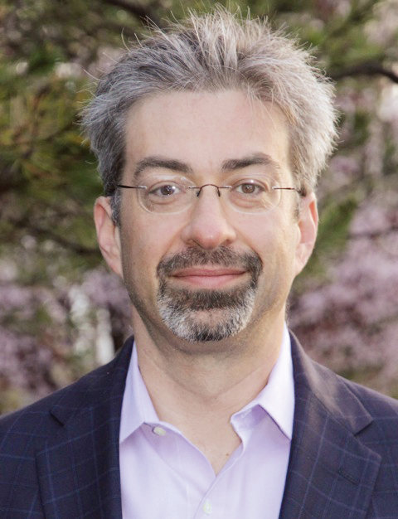
Press Release Stats:
3.8 Million Downloads
47,000 Education Registrations
15,000 MUG Members
14,000 MMS Users
500+ Commercial Customers
US$81 Million in Funding
Max Schireson Promoted to CEO
Notes:
3

Slide 4

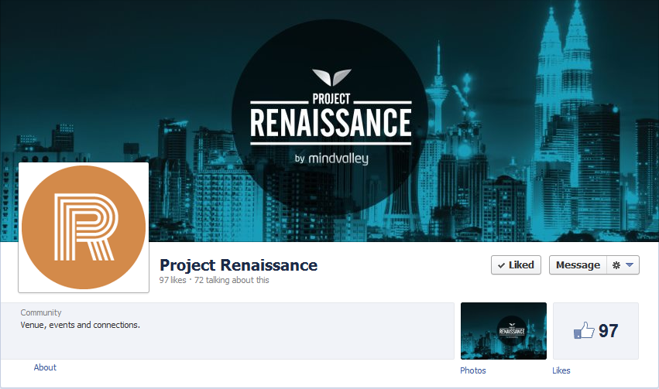
Big Data Week coming to KL – http://bigdataweek.com Project Renaissance - https://facebook.com/projectrenaissancekl
Notes:
4

Slide 5
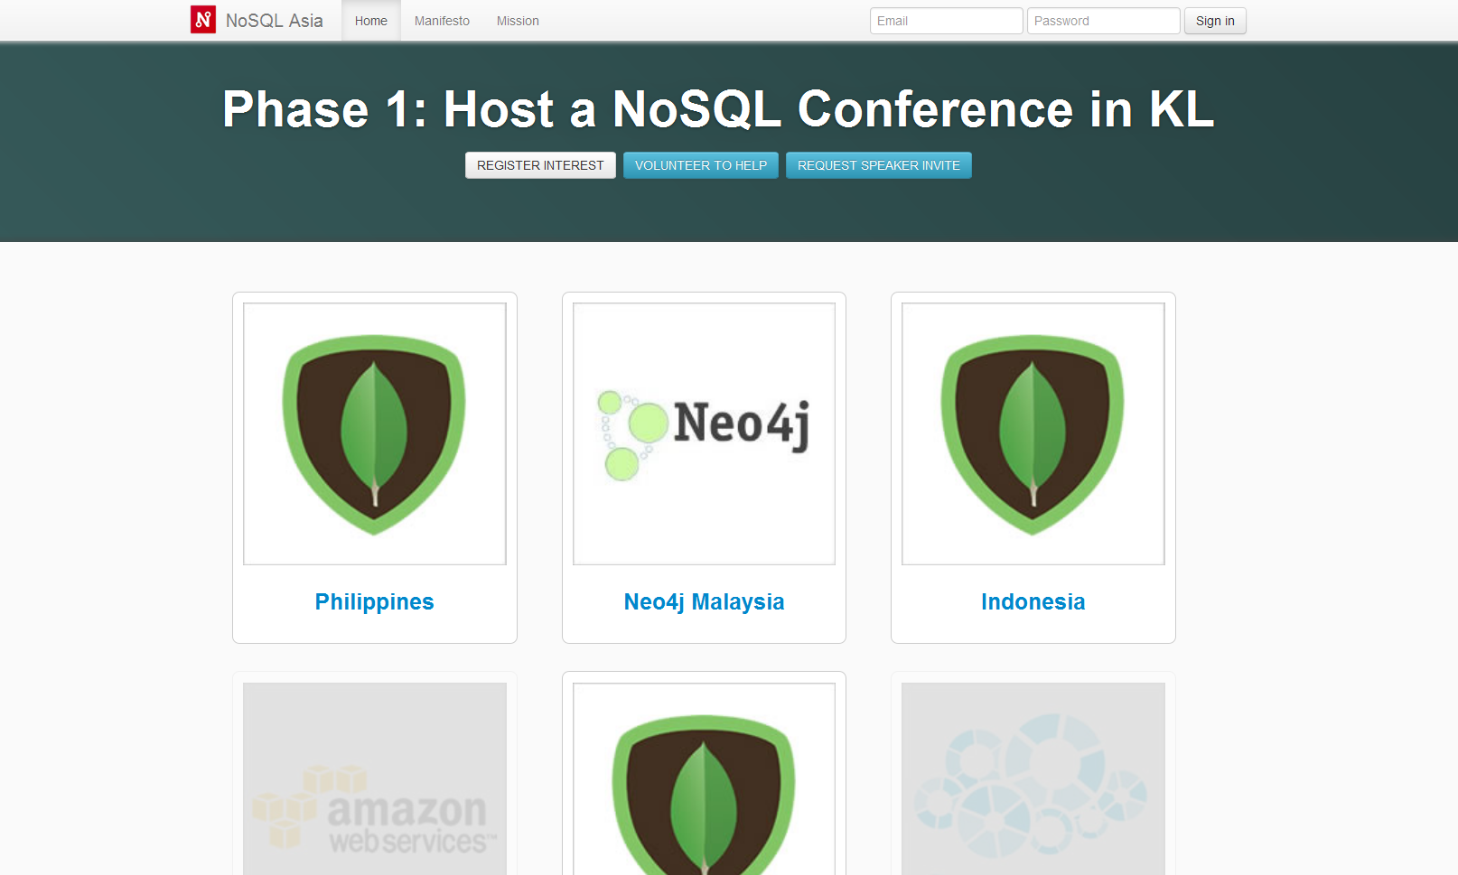
NoSQLasia.org @nosqlasia NoSQL KL on FB – http://facebook.com/groups/nosqlkl
Notes:
5

Slide 6
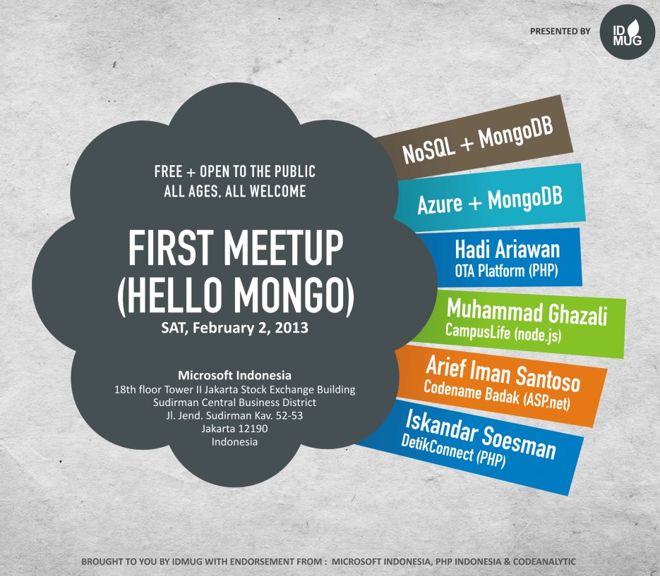
Notes:
6

Slide 7
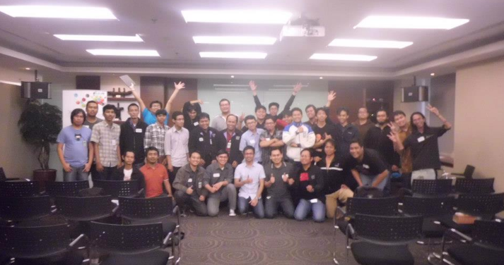
ID.MUG – 1st Meet-Up
http://idmug.org – 379 Members
Notes:
7

Slide 8
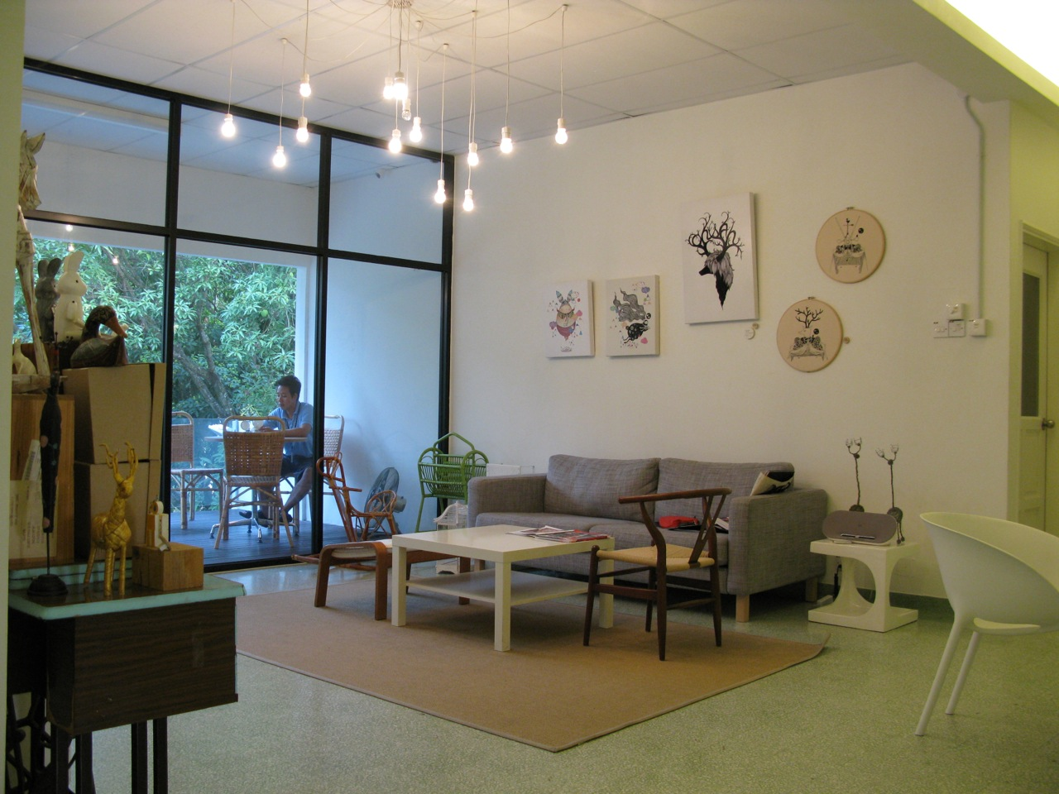
March 26th – Special MongoDB Event
14:00 until 20:00 – dinner at 19:00
Notes:
8

Slide 9
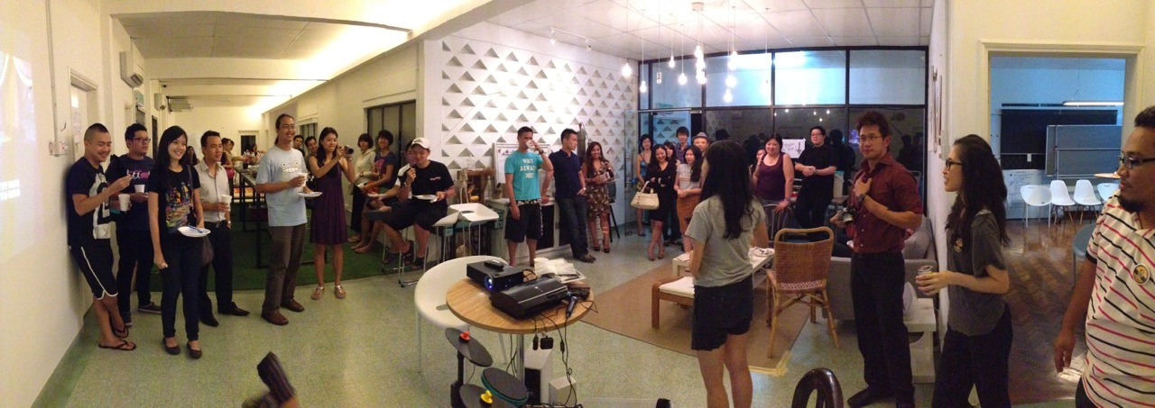
Nook Malaysia
http://nook.my
Notes:
9

Slide 10
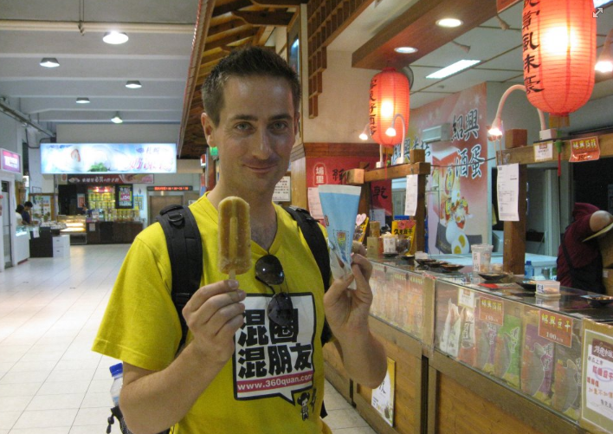
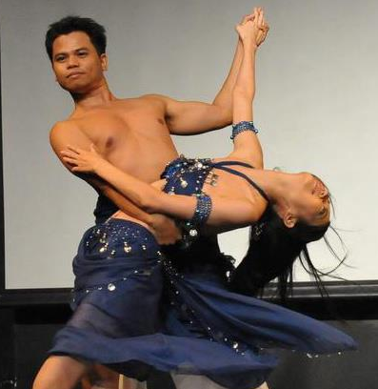
Building Web APIs
With Daniel Hjelm @dhjelm
Ruby & MongoDB
With Tristan Gomez @parasquid
Notes:
10

